Slide 1
Star Burst Block

Slide 2

Overview
Tetris + Story + Star Burst Stream
New Game Rule And Game System
Memes >>>>>>>> Content

Slide 3
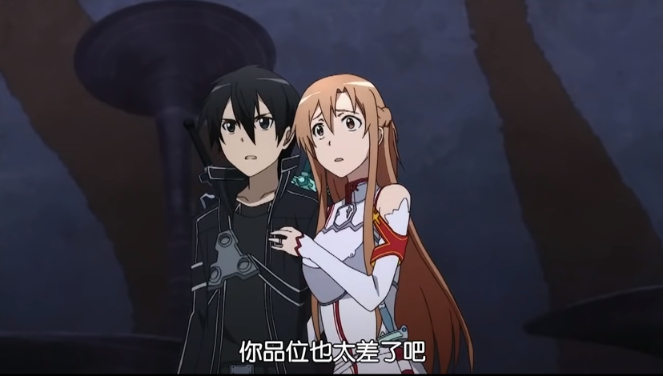
Bug
Feature
Complete Perfect UI
Realistic SFX And OST
Story And Animation
Special Battle System

Slide 4
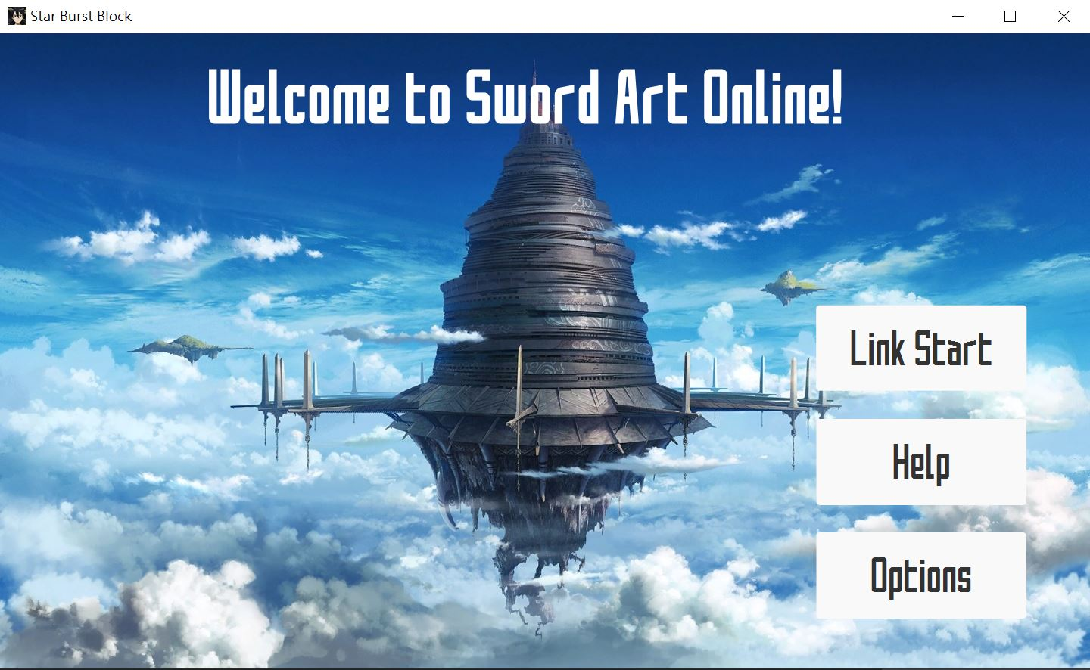
UI Preview

Slide 5
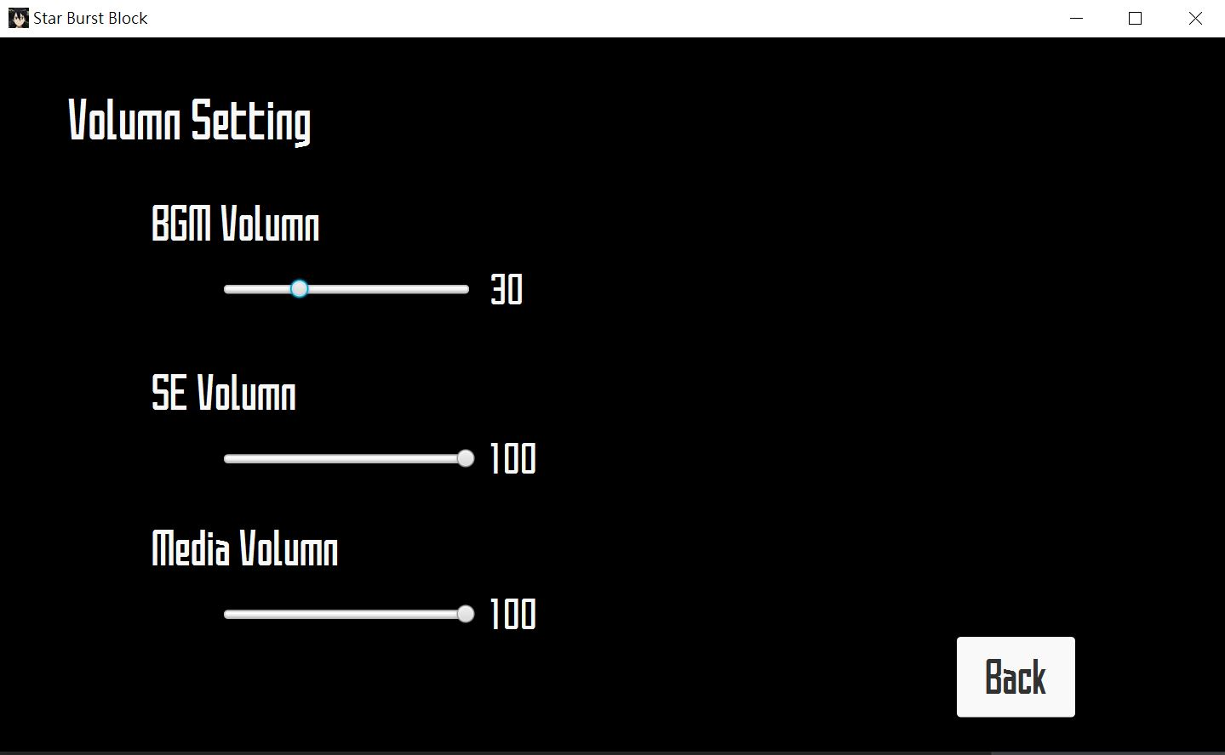
UI Preview

Slide 6
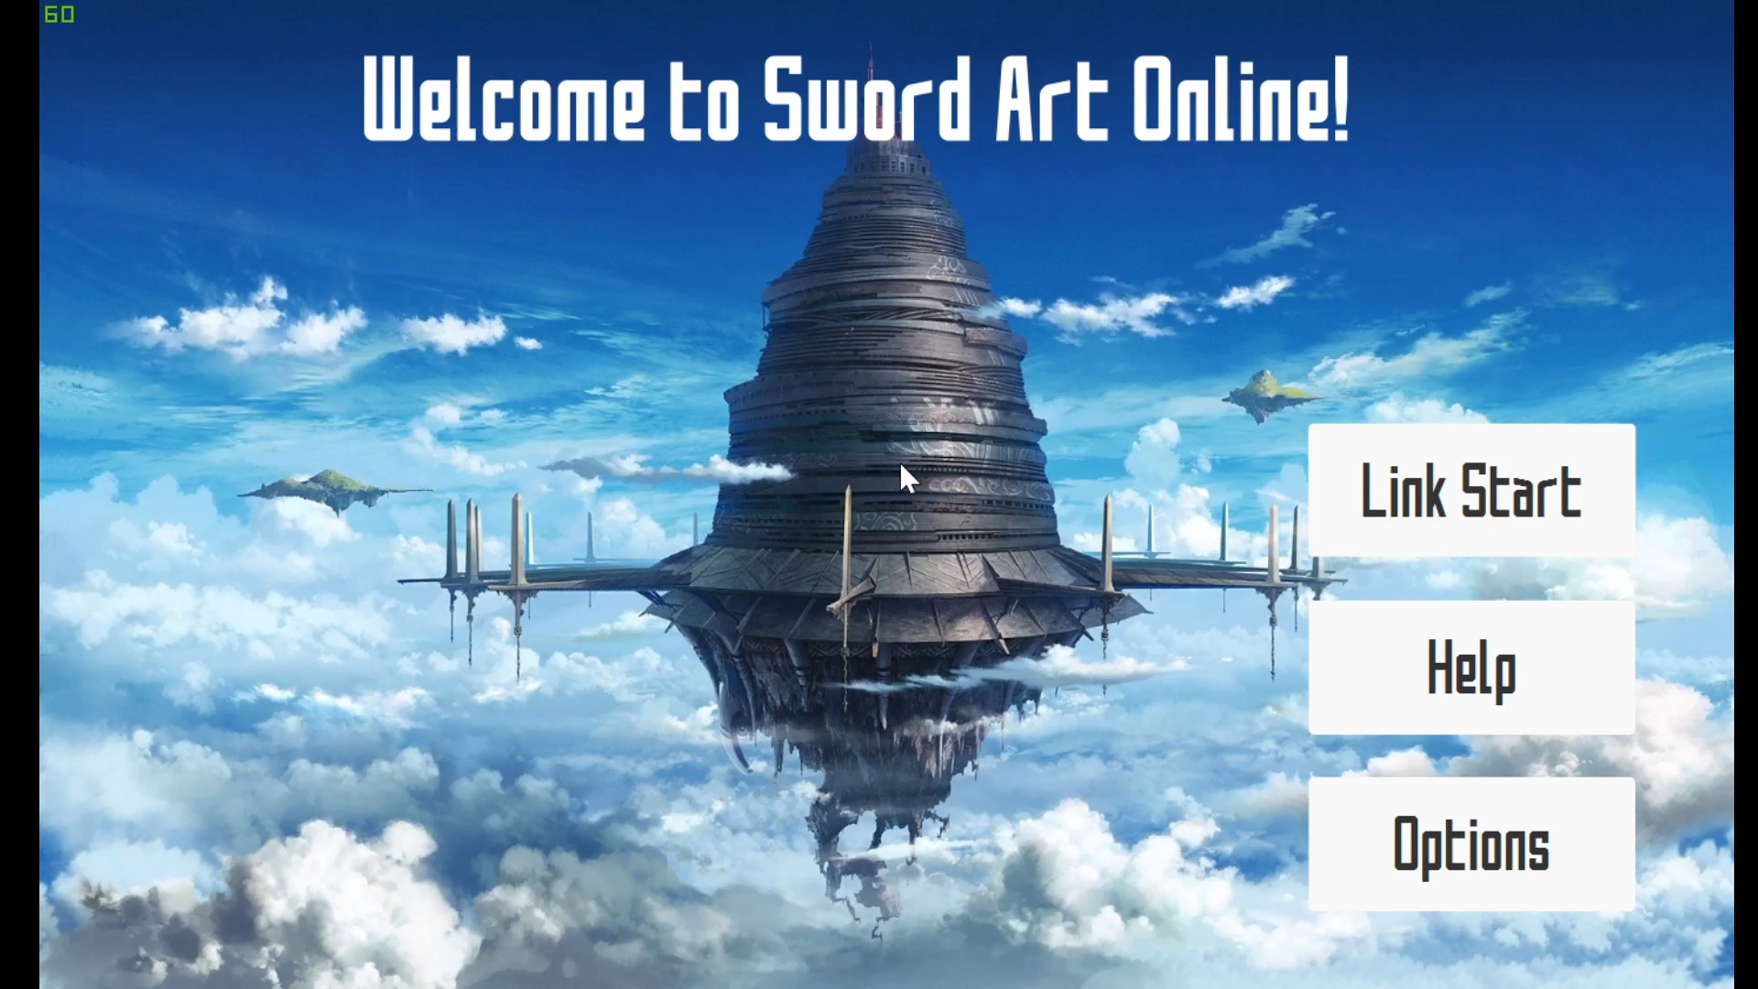
UI Preview

Slide 7
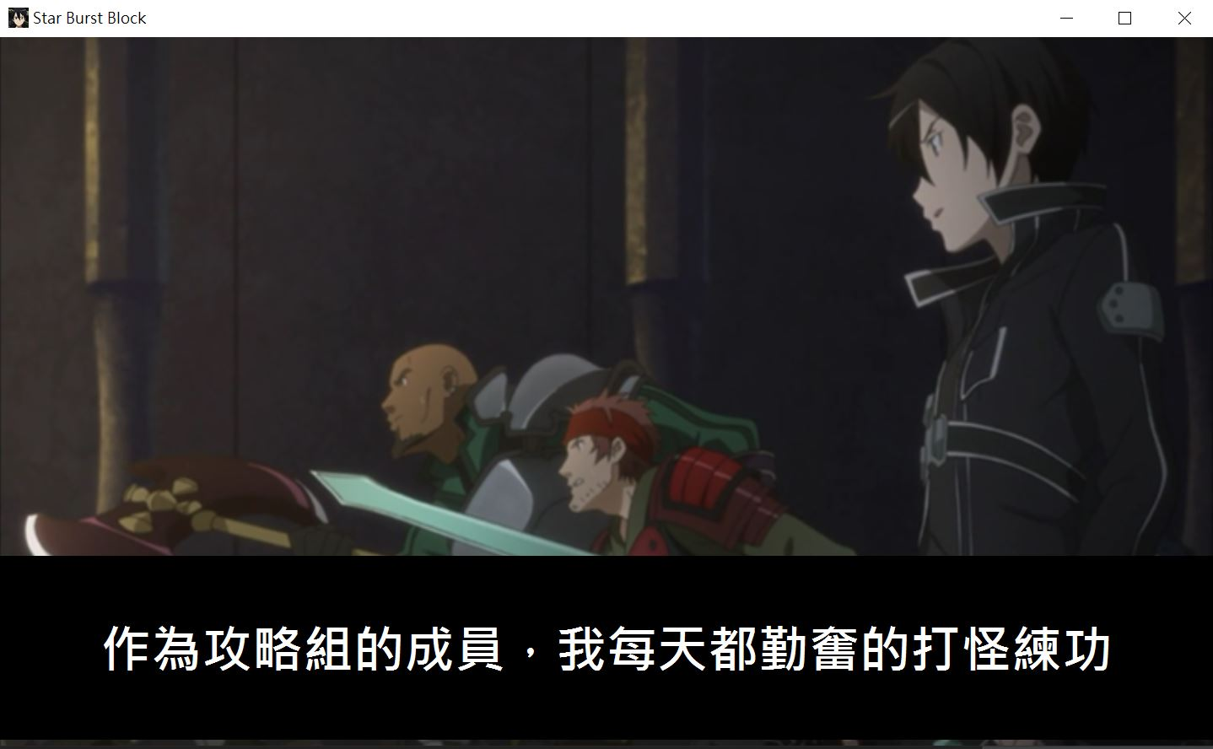
Story System
Simple Scripting Story System
With Picture And Text
Fade Transition
Skip Hot Key

Slide 8
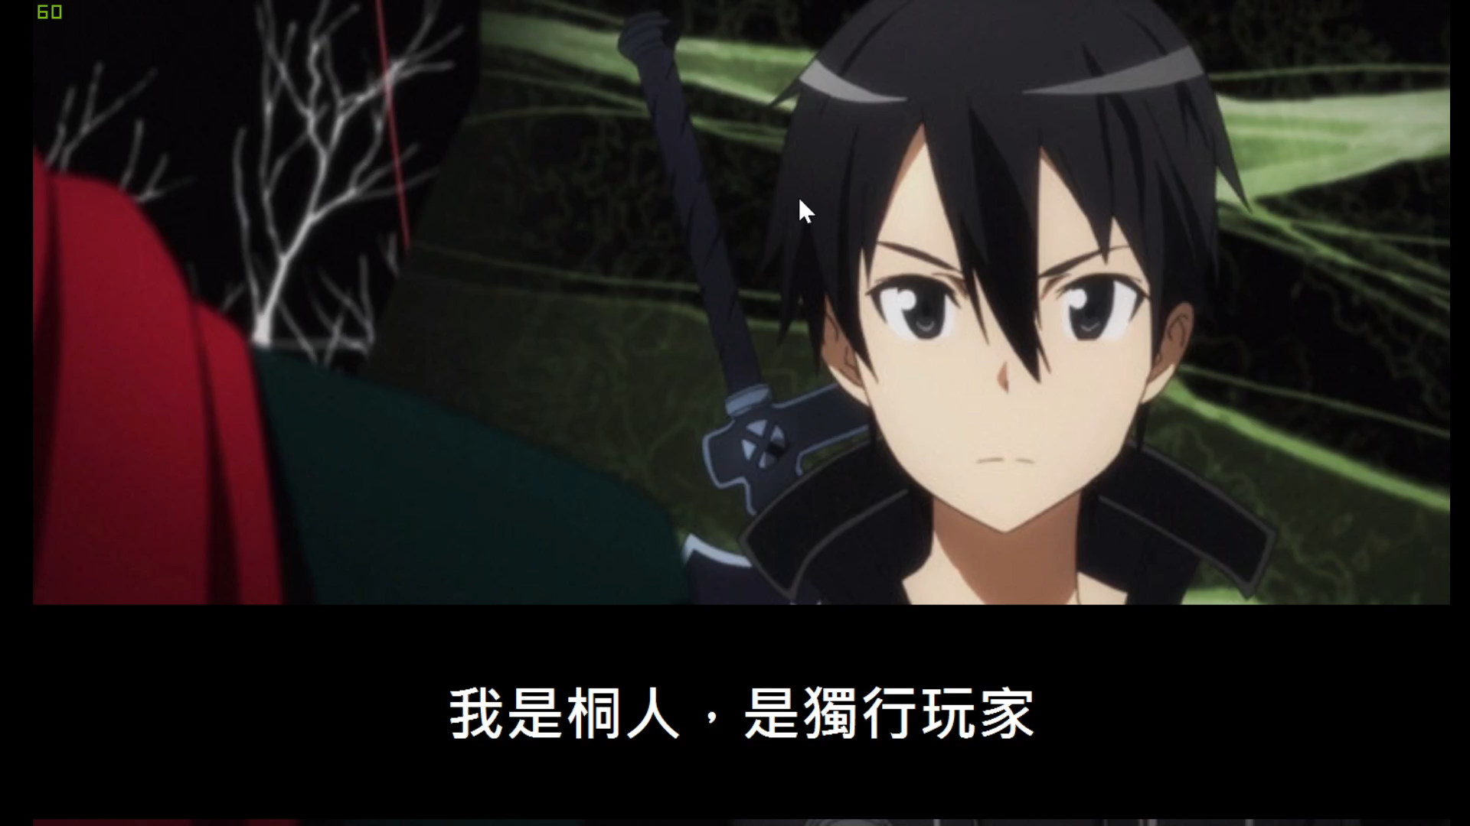
Story System

Slide 9

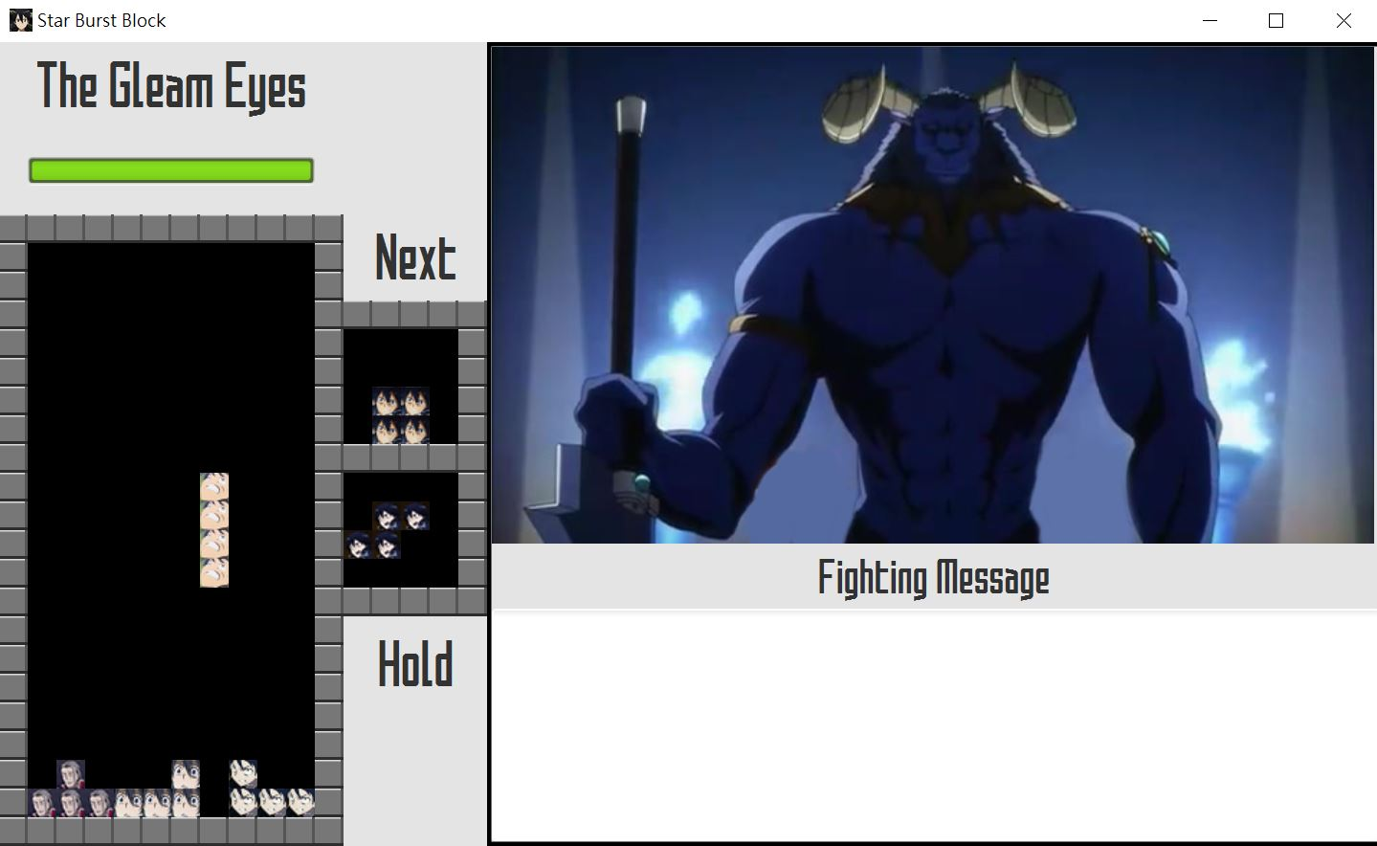
Game System
Simple Tetris Rule
No T-Spin / L-Spin
No Drop Preview
Boss’s Skill OPOP
Live Longer As You Can
Fighting Message Log

Slide 10
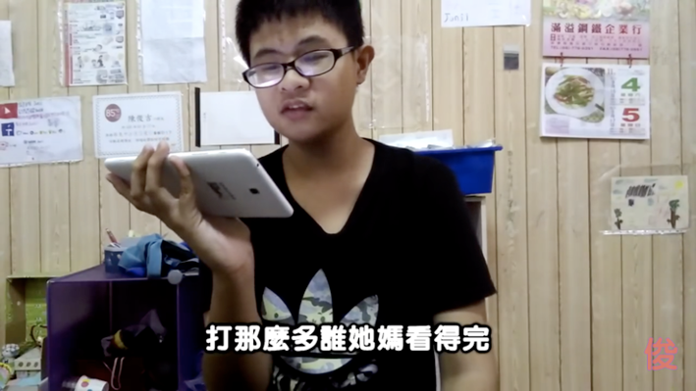
Technical Details
Resource Manager
Scripting Story System
Global Setting
Tetromino Implement
Kick Wall Spin
Boss Skills

Slide 11
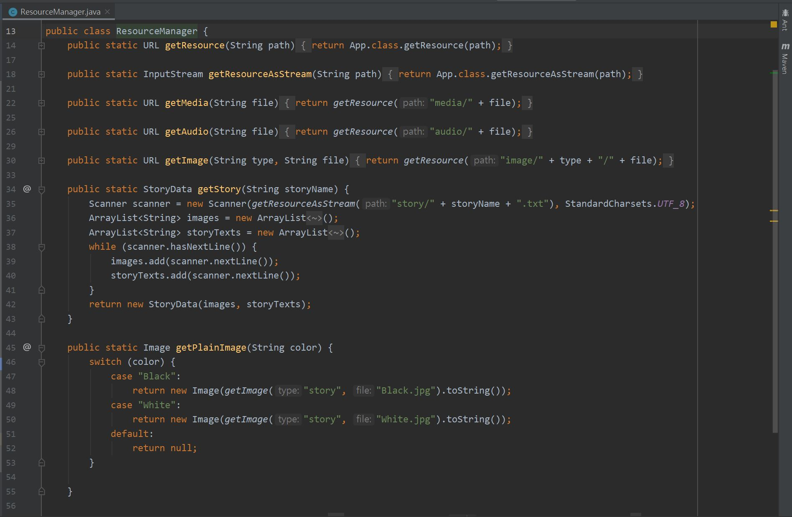
Technical Details
Resource Manager

Slide 12
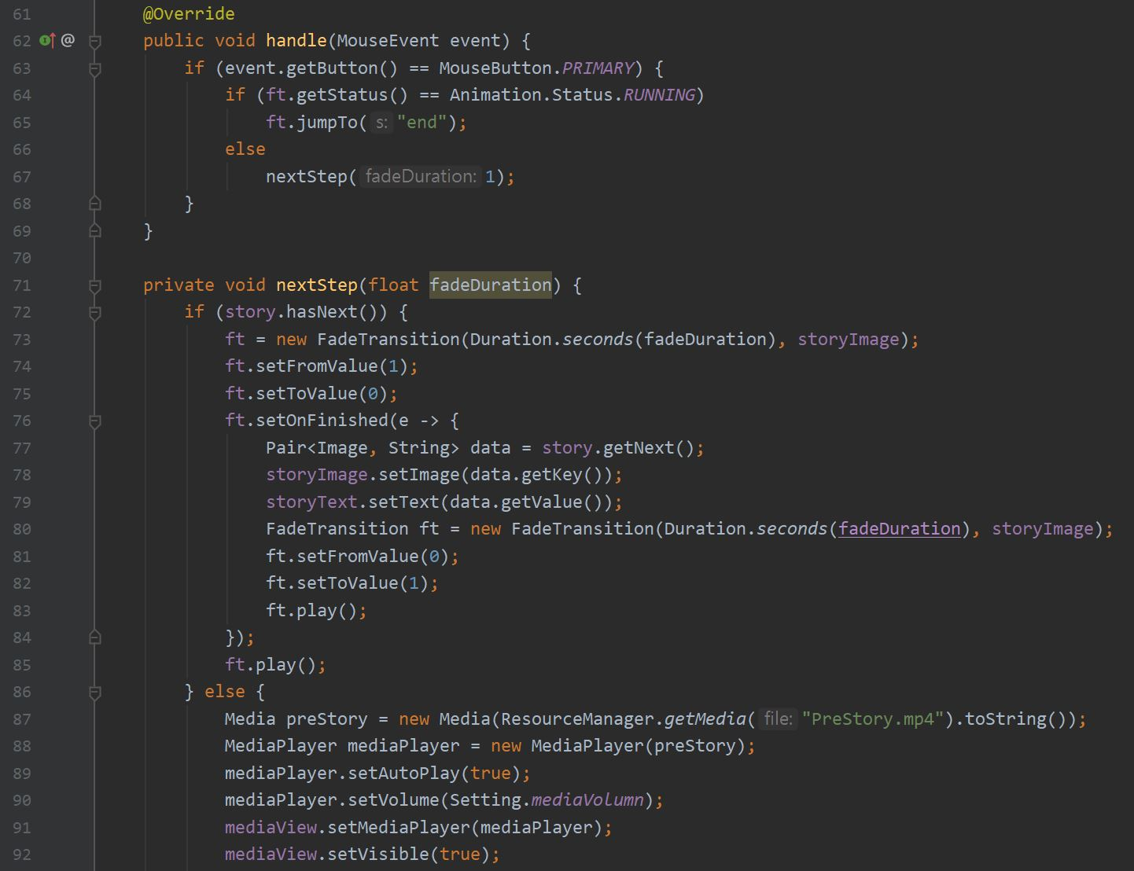
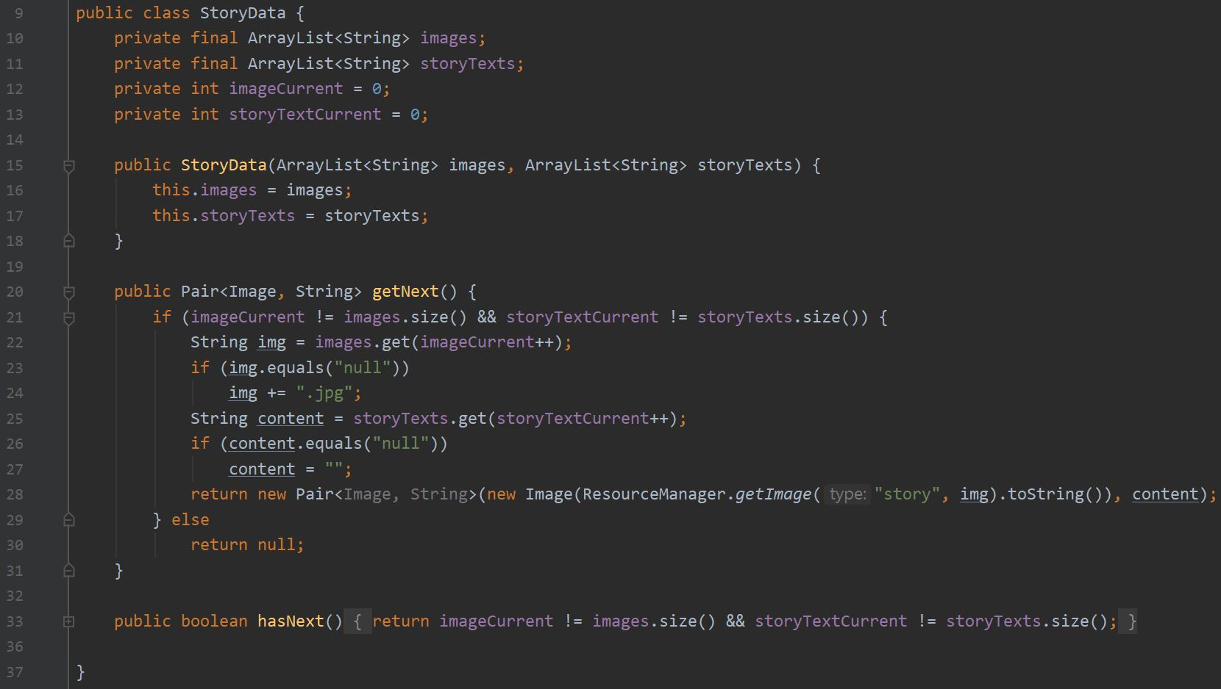
Technical Details
Scripting Story System

Slide 13
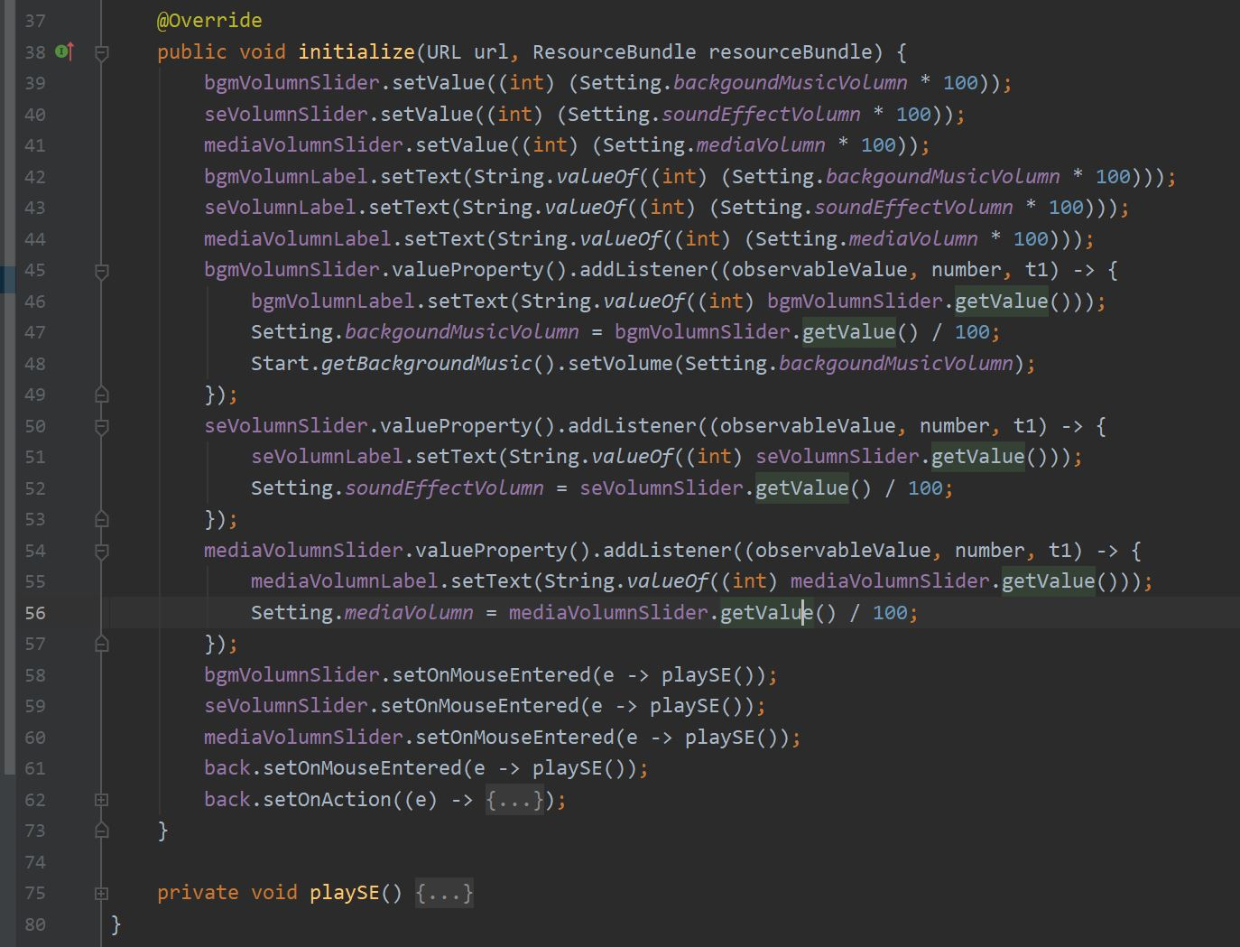
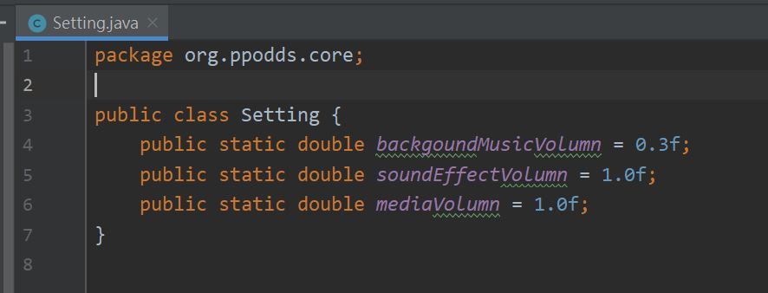
Technical Details
Global Setting

Slide 14
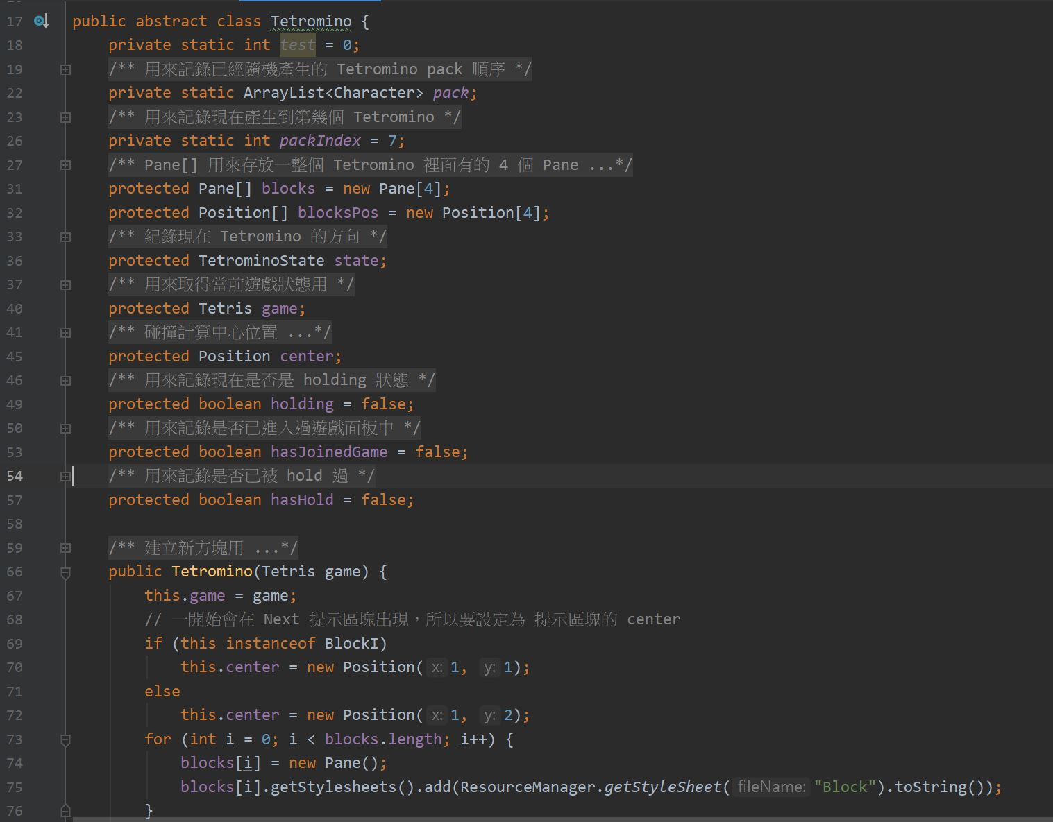
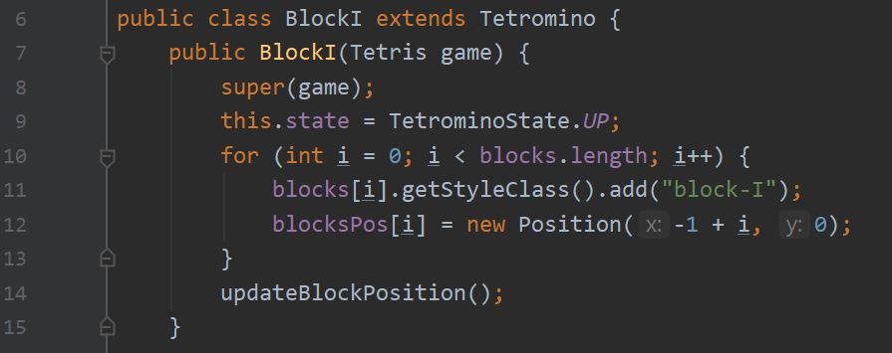
Technical Details
Tetromino Implement

Slide 15
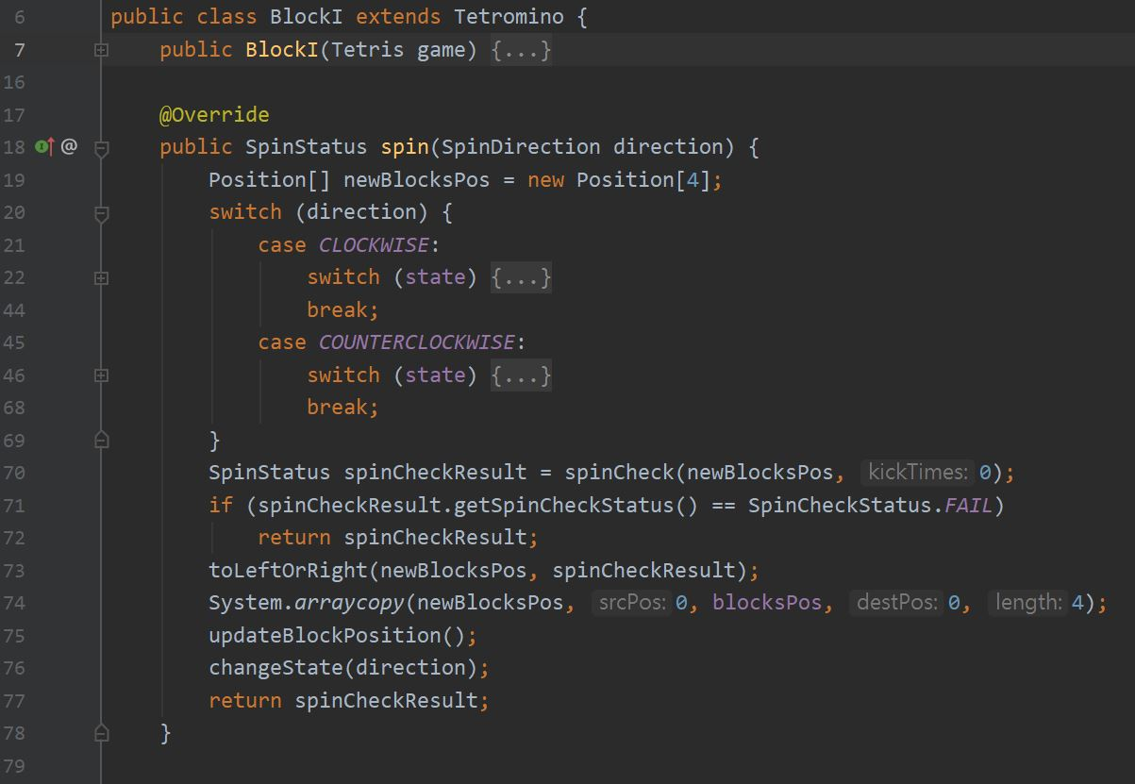
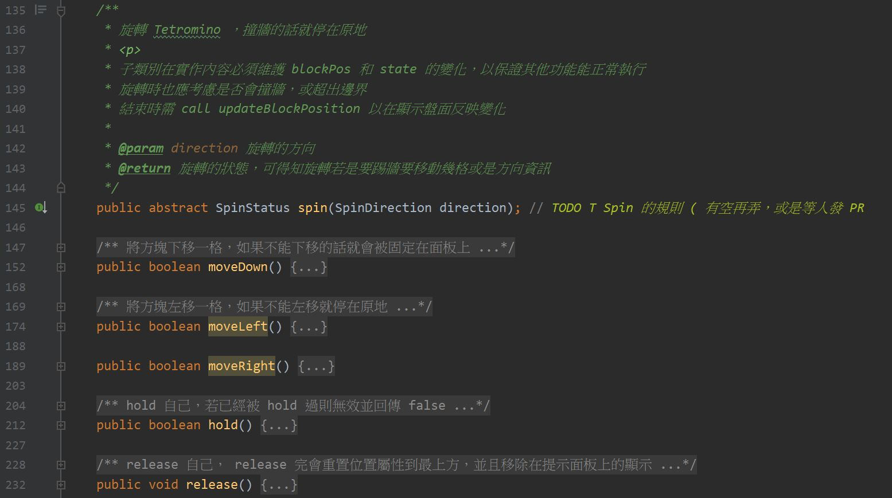
Technical Details
Tetromino Implement

Slide 16
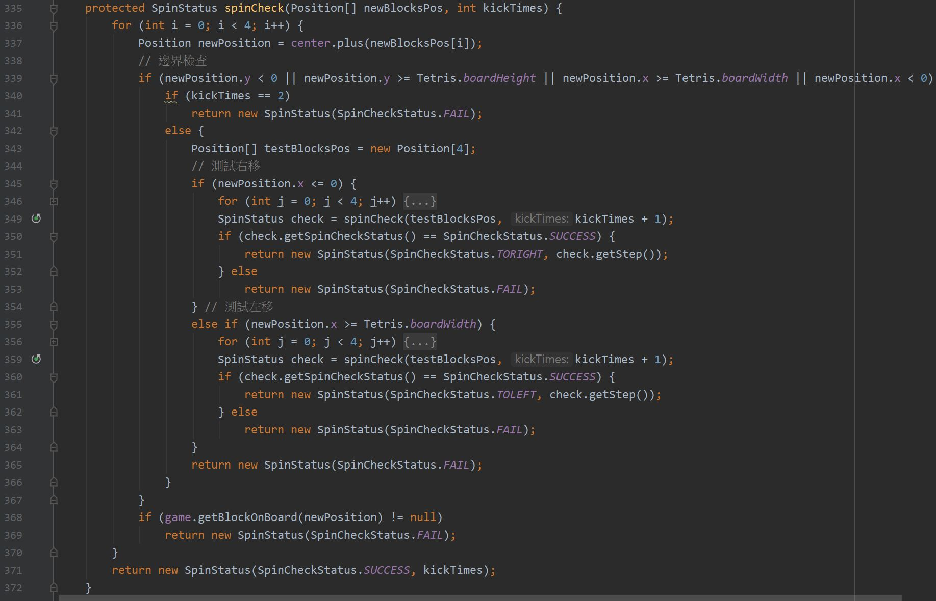
Technical Details
Kick Wall Spin

Slide 17
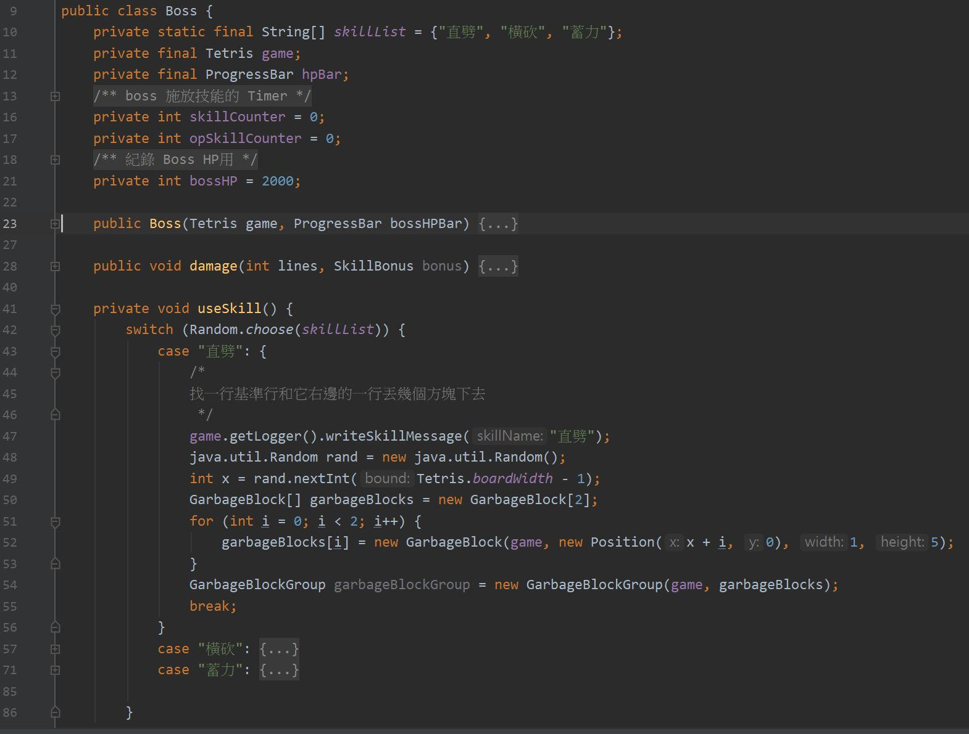
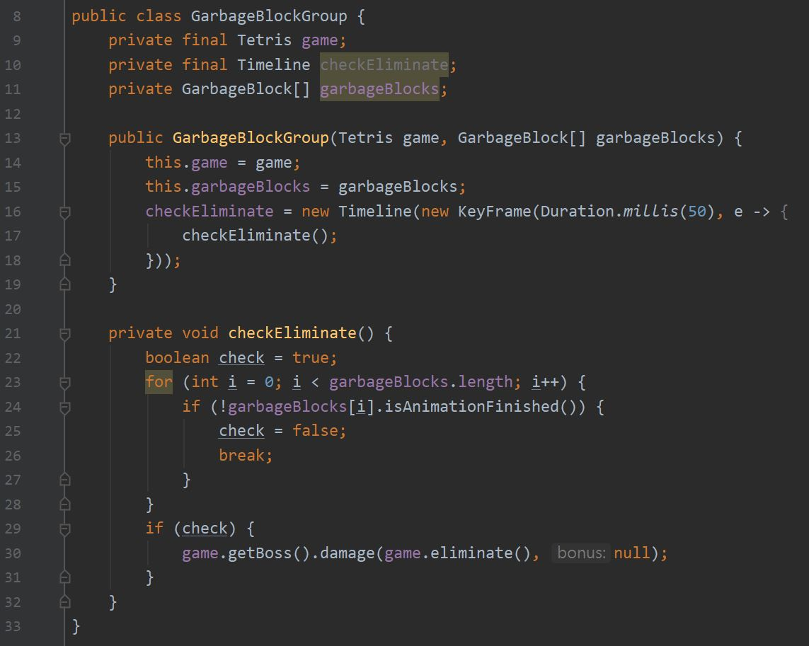
Technical Details
Boss Skills

Slide 18
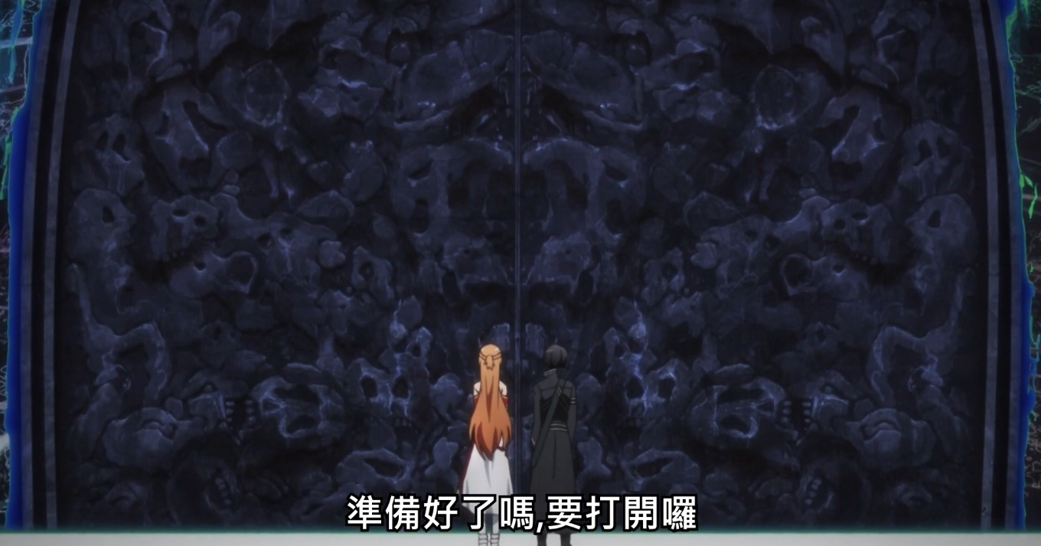
Demo
It’s Time For Join In

Slide 19
More Details
Source Code (GitHub)
https://github.com/ppodds/StarBurstBlock
Game Release
https://github.com/ppodds/StarBurstBlock/releases
Project Note And References
https://github.com/ppodds/StarBurstBlock/blob/master/Documents/Note.md
https://github.com/ppodds/StarBurstBlock/blob/master/Documents/References.md

Slide 20
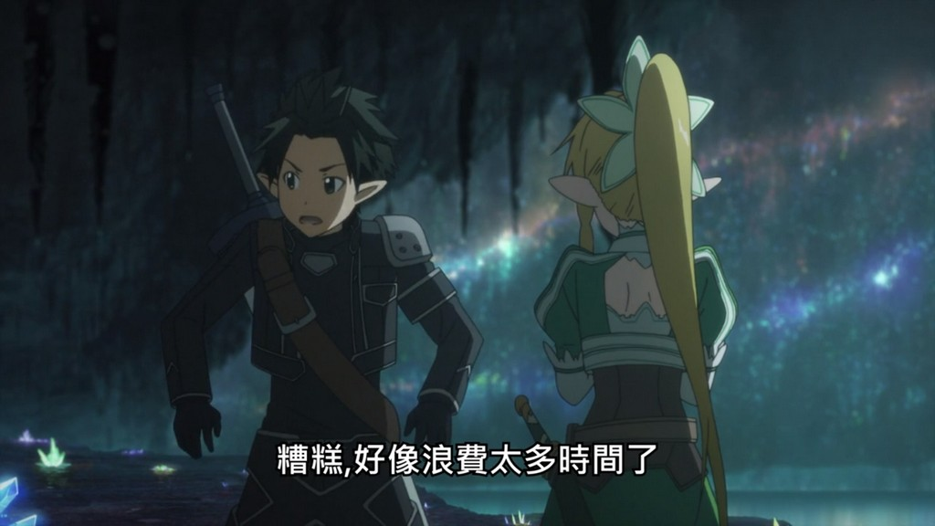
Thanks
If You Like This …
Give Me A Star On My GitHub Repository
Give Me Higher Score

